Slide 1
Exploratory Data Analysis:
Diabetes Prediction Set
By M. Ashura Langford

Slide 2
Introduction
What is Diabetes?
A chronic disease that occurs when the pancreas does not produce enough insulin or when the body can no longer effectively use the insulin that is produces (WHO)
Why should you care?
It is estimated that 240 million people live with undiagnosed diabetes, with nearly half being adults(NIH).
This disease has a significant mortality rate worldwide.
Notes:
Diabetes is a rapidly growing global health crisis that can be characterized by persistently high blood glucose levels, which lead to severe cardiovascular, renal, and even neurological complications. Understanding the complex relationship between demographic, clinical, and lifestyle factors is essential to creating effective interventions for overall public health.

Slide 3
What variables does the Diabetes Prediction Dataset look at?
Physical Activity, Smoking Status, Alcohol Consumption
Ethnicity,Age, Sex
HbA1c
Cholesterol & Blood Pressure
Fasting Blood Glucose
Body Mass Index
Notes:
This project focuses on conducting an Exploratory Data Analysis using the Diabetes Prediction Dataset uploaded by user, Marshal Patel2558. This dataset contains about 10,000 entries across 21 columns, which encompass a wide array of health metrics and potential risk factors. The key variables for analysis include demographic information(ethnicity, sex, age), essential clinical indicators(HbA1c, Fasting Blood Glucose, BMI, Blood Pressure, and Cholesterol levels), and lifestyle factors(Physical Activity Level, smoking status, and alcohol consumption).
The main objective of this project is to thoughtfully explore the dataset, creating clear and insightful visualizations, while also exploring interesting patterns related to diabetes risk.

Slide 4
Research Questions
Which features appear most strongly associated with diabetes status (e.g., Age, BMI, Glucose, Family History, Activity Level)?
Which demographic groups (by age, gender, ethnicity, or BMI category) show higher risk profiles?
  How does the proportion of individuals in different BMI categories look across categories like sex, age, and ethnicity?
How do lifestyle factors (alcohol use, activity level) relate to diabetes or prediabetes indicators?
Are there combinations of risk factors that seem particularly important?
How does the distribution of high-risk glucose categories (Pre-diabetes and Diabetes) evolve across BMI Categories as the population ages?
How does the trade-off between the two primary cardiovascular risk factors(Blood Pressure and Cholesterol) differ between individuals with a normal glucose status versus those with diabetes?

Slide 5
Data Cleaning and Data Understanding
Data Cleaning:
Unknown Column was dropped
Alcohol Consumption was missing 3,320 values
Mode imputation was used for Alcohol Consumption Column
  Mode was Moderate
Converted all columns to category types
Data Understanding:
Created new categories based on clinical measures:
  BMI Category
  Glucose Control Status
  Age Group
  Fasting Blood Glucose Risk Level

Slide 6
Understanding the New Categories
Age Group
 | Young Adult | Middle-Aged | Senior | Elderly
Age | <30 | 30 to 50 | 50 to 65 | >65
BMI Category
*Based on NHC Inform* | Underweight | Normal Weight | Overweight | Obese
BMI | <18.5 | 18.5 to 24.9 | 25 to 29.9 | >30
Glucose Status
*Based on CDC* | Normal | Pre-Diabetes | Diabetes
HbA1c Levels | <5.7% | 5.7% to 6.4% | >6.5%

Slide 7
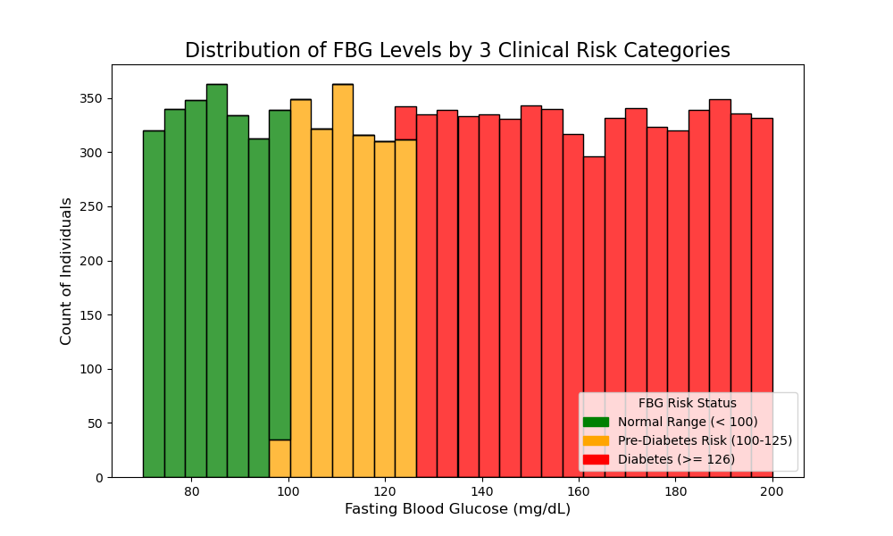
Which features appear most strongly associated with diabetes status?
More individuals in the Diabetes category, which means FBG is a good predictor for diabetes diagnoses.
Notes:
The most strongly associated features are the clinical measures for glucose control.
Glucose metrics, such as HbA1c and Fasting Blood Glucose, showed that an overwhelming portion of the population has impaired glucose control, with 7,784 individuals within the Diabetes category based on their reported HbA1c and 5,671 individuals in the high-risk category based on their fasting blood glucose.

Slide 8
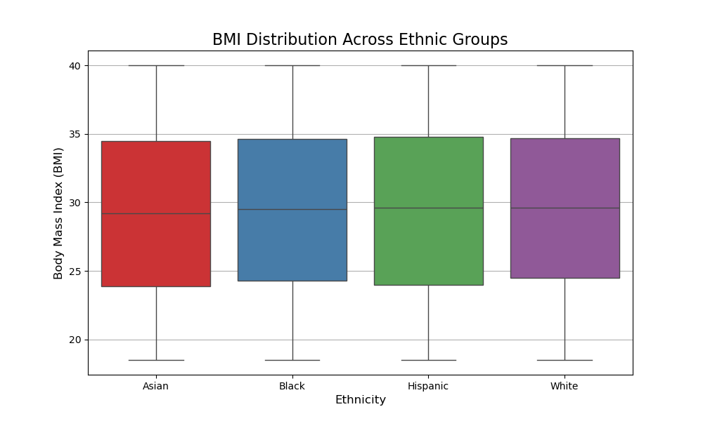
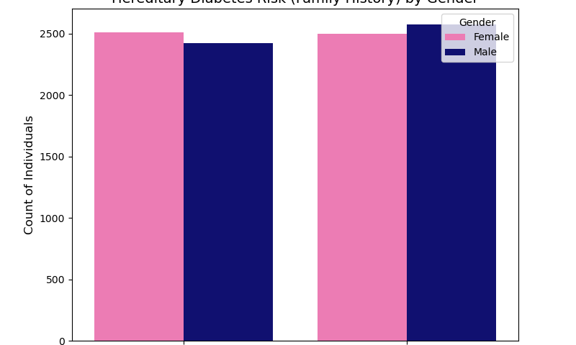
Which demographic groups show higher risk profiles?
The dataset was dominated overall by the higher BMI categories, with the obese category containing the largest single count of 4,785.
Notes:
There were differences across the age groups. The most prominent high-risk group was the obese category, which, when aged was accounted for, showed that Middle-Aged(4,094) and Senior(2,985) age groups represented the greatest overall count of individuals within the diabetes status, I will dive deeper into this later. There were no drastic differences in BMI across ethnic groups; however, the Hispanic groups had the highest median BMI. Obesity seems to be a significant issue across all ethnic groups.
-In the context of gender, males show a slightly greater predisposition to diabetes risk based on having a family history of diabetes. There were no drastic differences in BMI across sex.

Slide 9
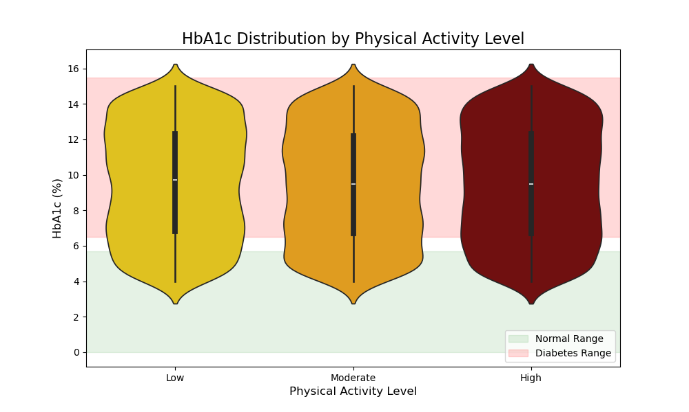
How do lifestyle factors (alcohol use, activity level) relate to diabetes or prediabetes indicators?
Lower activity levels most likely leads to higher HbA1c levels.
Notes:
there is somewhat of a relationship between the lower activity level and higher HbA1c levels. As there is a wider distribution of glucose values and a higher concentration in the diabetic range. This indicates that lower physical activity is associated with poorer glucose control, leading to a higher risk of developing diabetes.

Slide 10
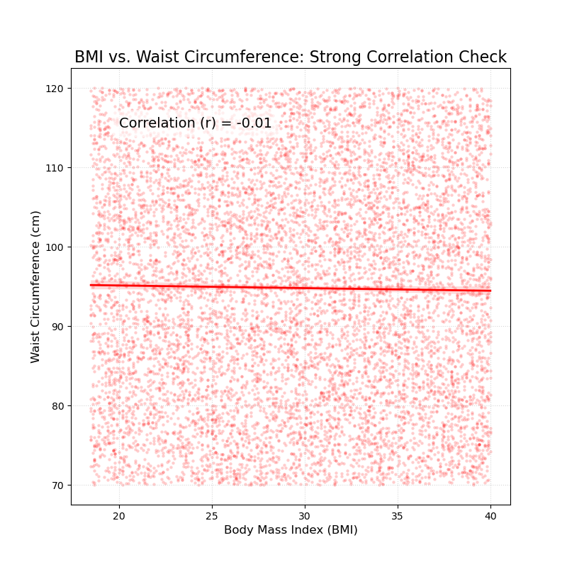
Are there combinations of risk factors that seem particularly important? And what results disappointed you?
Interactive Histogram:
Middle-Aged
Senior
Obese group dominated
Notes:
Similar to what was stated earlier, the combination of the Obese BMI category with the Middle-Age and Senior Age group consistently represents the highest count of people with diabetes across all age groups. This suggests that age could be a predictive factor for diabetes. The transition from middle-aged to senior, combined with high BMI, could put individuals at a higher risk of developing diabetes. Please note that obesity dominated across all age groups.
BMI and waist circumference showed a slightly negative correlation, but it was not significant enough for BMI to be a predictive factor for waist and vice versa.

Slide 11
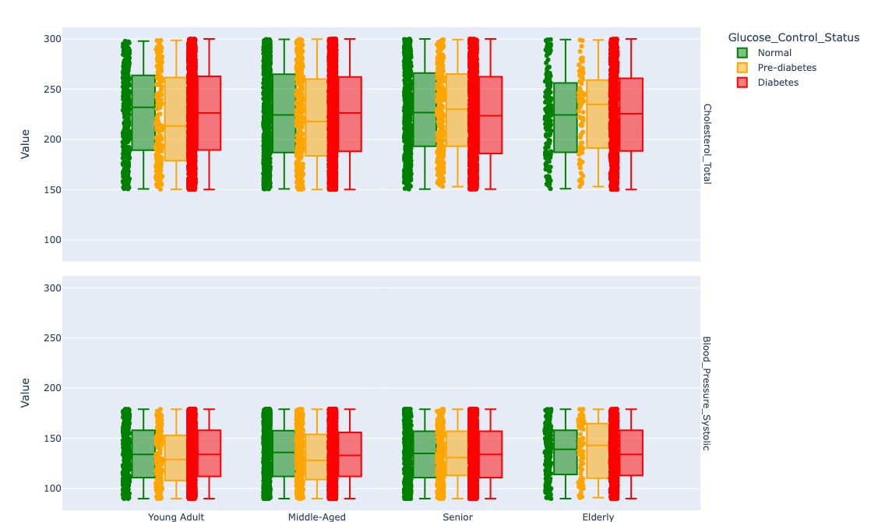
How does the trade-off between the two primary cardiovascular risk factors between individuals with a normal glucose status versus those with diabetes?
Notes:
The box plots highlight a severe trade-off showing that poorer glucose regulation is associated with elevated cardiovascular risk. The diabetes group exhibits a consistently higher median for Cholesterol Total and even higher medians for Blood Pressure Systolic when compared to the normal group. The differences in both cardiovascular measures are most prevalent when looking at the Normal group and comparing them to the Pre-diabetes and Diabetes groups across all ages. The position of the margin boxes shows that poor glucose regulation, regardless of age, increases the median cardiovascular risk.

Slide 12
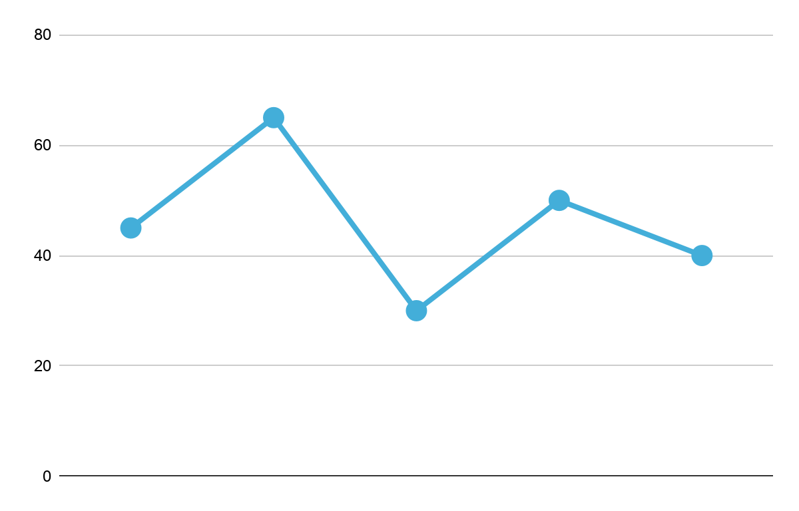
Limitations
Reporting Bias
Poor Data Collection
All lifestyle choices are reported by the participant.
Missing essential variables
About 30% of data was missing in the alcohol consumption column
Mode imputation introduces more bias, so is column could not be explored
65%
Possible Sampling Bias
40%
50%
40%
Overrepresentation of high risk individuals
30%
Notes:
This analysis and dataset are subject to several inherent limitations, which should be considered before applying these findings to a political or clinical context.
First, there is high sampling bias towards individuals with impaired glucose control, with almost all participants falling in the Diabetes category. This overrepresentation implies the sample is not reflective of the general population’s diabetes prevalence, which means there is potential for sampling bias. It could be that the study was advertised at a clinic with patients at high risk for diabetes, or there was selective participation. This could be fixed in the future by adding diversity in sample location(areas with different socioeconomic classes, states, etc) when boosting the study.
Another limitation is the lack of several critical values for a comprehensive idea of diabetes management. There is an absence of data for medication adherence(whether they take medicine for diabetes) or dietary habits(beyond caloric intake); the absence of these key variables limits the ability to conclude treatment or lifestyle factors. Another limitation was the large amount of data missing from the “Alcohol Consumption” column, which led to mode imputation. This cleaning decision was done to preserve sample size, but it introduced more bias, which nullified the ability to create meaningful relationships.
Finally, although clinical markers(FBG, HbA1c, etc) are likely measured, the reports on lifestyle choices (physical activity, smoking status, etc) are likely self-reported. This introduces reporting bias, where people may over-report positive or under-report negative behaviors, which can lead to measurement errors, thus hindering the analysis of the data.

Slide 13
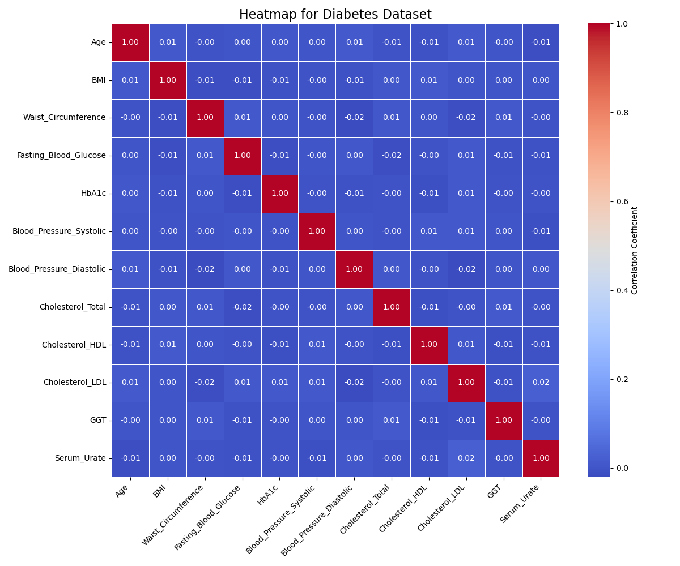
Future Direction
5.8
Public Interventions that prioritize increasing physical activity and weight management in our aging populations.
To be explored:
What role does smoking status play in increasing the risk of diabetes across age groups?
Can high activity mitigate the risk of diabetes in individuals with higher body mass index?
Notes:
Based on the findings of the analysis, there isn’t sufficient evidence to provide any type of policy recommendations as there were overwhelmingly low correlations between most variables.
However, the results when looking at BMI groups and age groups suggested that Middle-Aged and Senior individuals with higher BMI are at a higher risk of diabetes. Due to this, implementing policies that strongly target these high-risk groups would be effective. Public programs and campaigns should focus on culturally sensitive weight management and increased physical activity within these high-risk groups to decrease the progression of pre-diabetes to over diabetes. Increasing activity is essential as the low activity group showed the poorest glucose control.

Slide 14
The End!
8.5

Slide 15
References:
American Diabetes Association Professional Practice Committee. (2022). 2. Classification and diagnosis of diabetes: Standards of medical care in diabetes—2022. Diabetes Care, 45(Supplement_1), S17–S38. https://doi.org/10.2337/dc22-S002
CDC. (2025, January 8). A1c test for diabetes and prediabetes. Diabetes. https://www.cdc.gov/diabetes/diabetes-testing/prediabetes-a1c-test.html
Checking your browser—reCAPTCHA. (n.d.). Retrieved December 1, 2025, from https://www.kaggle.com/datasets/marshalpatel3558/diabetes-prediction-dataset
Diabetes. (n.d.). Retrieved December 2, 2025, from https://www.who.int/news-room/fact-sheets/detail/diabetes
Hossain, Md. J., Al‐Mamun, Md., & Islam, Md. R. (2024). Diabetes mellitus, the fastest growing global public health concern: Early detection should be focused. Health Science Reports, 7(3), e2004. https://doi.org/10.1002/hsr2.2004
How do i measure my body mass index (Bmi)? (n.d.). NHS Inform. Retrieved December 1, 2025, from https://www.nhsinform.scot/healthy-living/weight-loss/understanding-healthy-weight/how-do-i-measure-my-body-mass-index-bmi/

